Slide 1
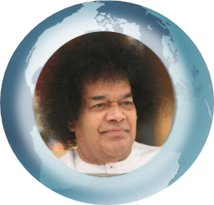

Prayers for Global Peace and Purification
Bhajan Lyrics goes here
Enter Meaning here
2 P Major
Enter Next Bhajan here
3P Major

